Slide 1
Data Analysis: Sales Prospects from Home Mortgage Data

Slide 2
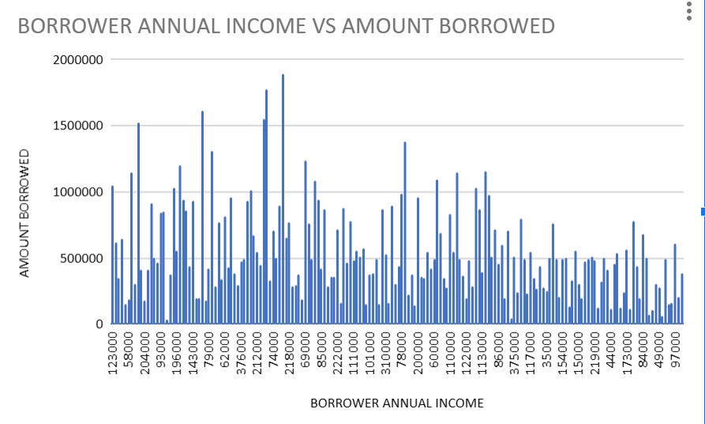
This chart gives a clear view of how many people who’s annual income & borrowing rate is shown.

Slide 3
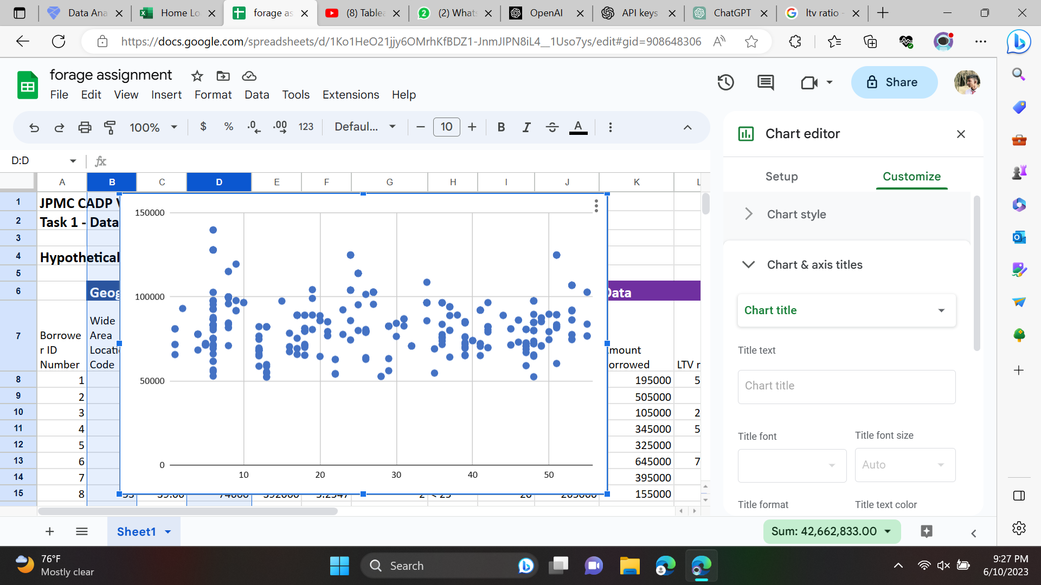
Area code vs Median Income as per the Area code
People in the Area Code 6 are the maximum, which has the highest Median Income
People in the Area Code 2,15 are minimum having least median income per area code

Slide 4
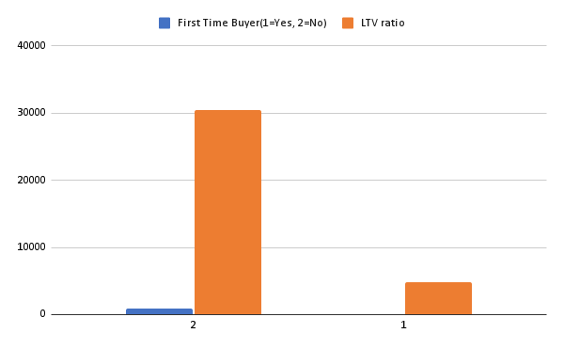
Loan to value ration to Bond Buyers
People who are not the First Time Buyer have the highest LTV ratio
Loan-to-value (LTV) is calculated simply by taking the loan amount and dividing it by the value of the asset or collateral being borrowed against.

Slide 5
Observation or data here…
77% of borrowers in the dataset have loan-to-value ratios of 80 or less.
• Annual incomes show a wide range of variation, possibly reflecting an imperfect
sampling of target area mortgages when the dataset was constructed.
• Combining LTV and annual income criteria generates 59 qualified, high income sales
prospects, which is just under 12% of the total borrowers in this dataset.
• Home values appear normally distributed with an average of about $430K.
• There are 85 borrowers in locations with a minority population greater than 50% in
the dataset, representing potential targets for community outreach and support.

Slide 6
Observations and Key Insights
Xxxxx
Xxxxx
xxxxx

